Slide 1
Gas Leakage Detection
System
Ayesha Iftikhar 23-NTU-CS-1021
Ayesha 23-NTU-CS-1020
Hajra Ahmad 23-NTU-CS-1034

Slide 2
Project Overview
Project Overview
  The system detects gas leaks using IoT technology to enhance safety with timely alerts locally and remotely.
Presentation Objectives
  The presentation covers the system's objectives, working principles, and future development possibilities.
  Team Composition
  We developed this project with mutual cooperation.

Slide 3
Introduction to Gas Leakage Detection
Safety Hazards of Gas Leaks
  Gas leaks can cause explosions, fires, and serious health risks in various environments.
Detection System Components
  The system uses an MQ-2 sensor and ESP32 microcontroller for real-time gas leak detection.
Alert and Notification Features
  Alerts via buzzer, exhaust fan activation, OLED display, and mobile app notifications ensure timely response.

Slide 4
Objectives of the Project
Gas Leak Detection
  Utilizes MQ-2 sensor to accurately detect the presence of harmful gas leaks in the environment.
Real-Time Monitoring
  Displays gas concentration levels on an OLED screen for immediate and clear monitoring by users.
Automatic Safety Response
  Activates exhaust fan and buzzer automatically when gas levels exceed the safe threshold to ensure safety.
Remote Alerts and Monitoring
  Sends real-time alerts to users through IoT platform and enables remote safety monitoring anytime, anywhere.

Slide 5
System Architecture and Flow
Sensor and Microcontroller
  MQ-2 sensor captures gas levels and sends data to the ESP32 microcontroller for processing and decision making.
Local Alert Mechanism
  The ESP32 controls a relay to activate an exhaust fan and buzzer for immediate local gas leak alerts.
Display and Monitoring
  An OLED display provides real-time gas concentration readings, enhancing local monitoring capabilities.
Remote IoT Integration
  Integration with Blynk IoT platform enables remote monitoring and mobile notifications via cloud dashboards.

Slide 6
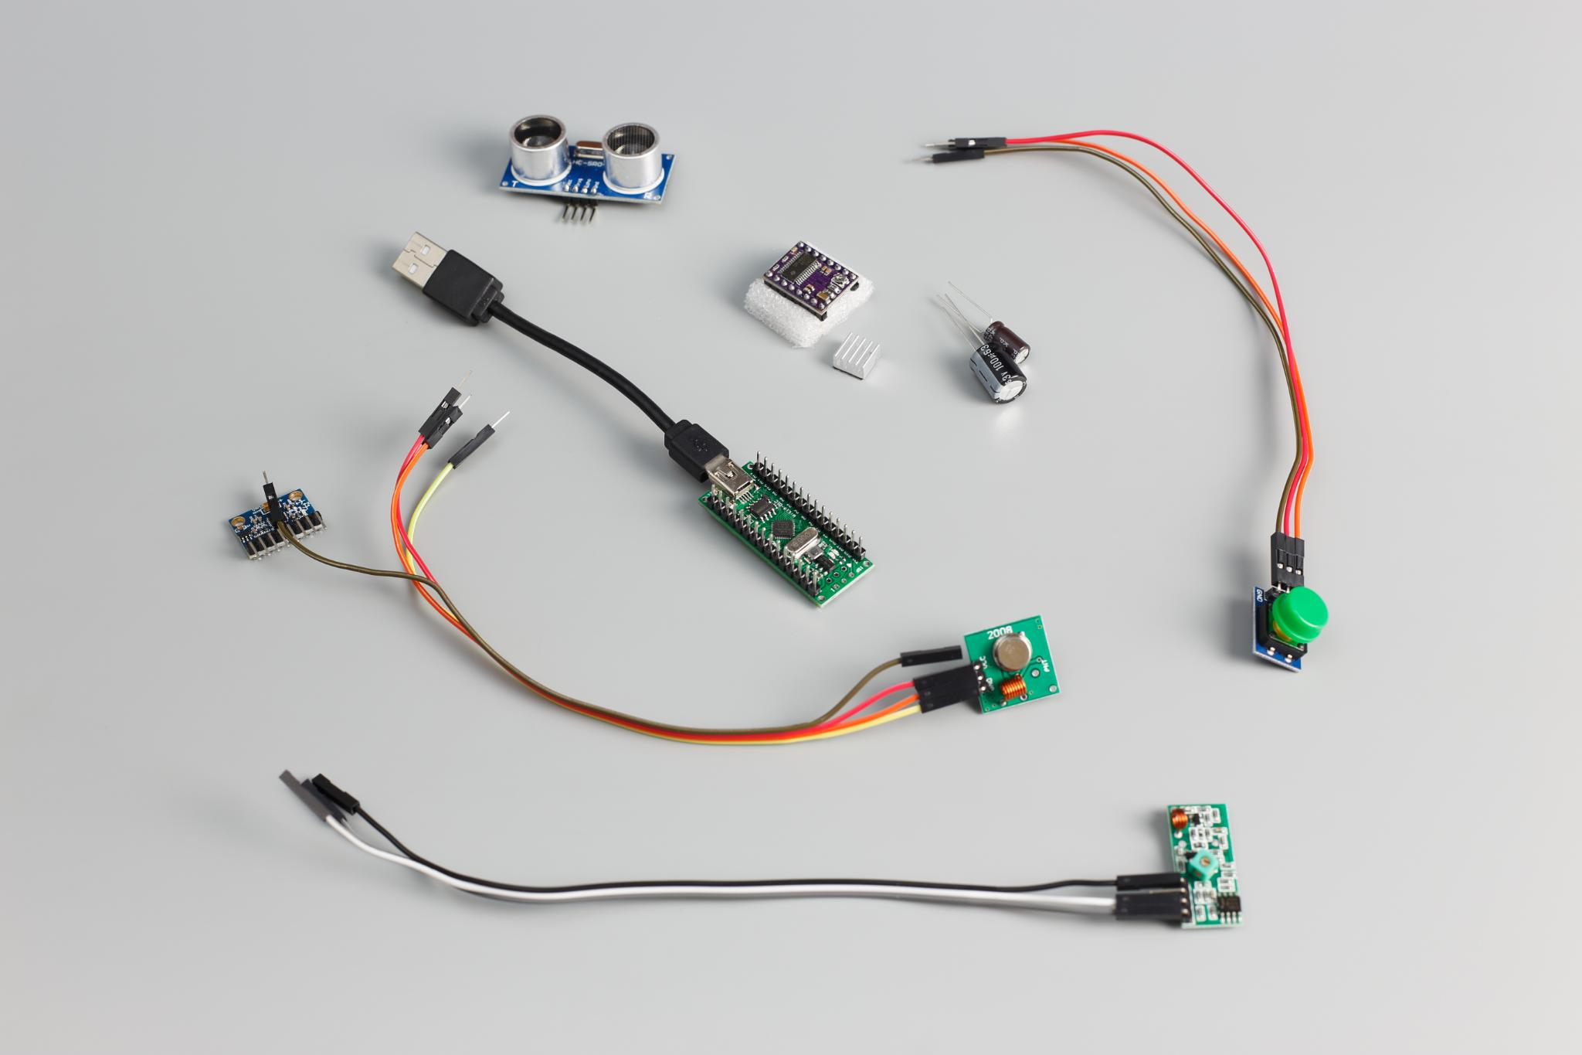

Hardware and Software Components
Core Hardware Components
  ESP32 microcontroller, MQ-2 gas sensor, OLED display, relay module, buzzer, exhaust fan,
  jumper wires, and breadboard form the system hardware.
  Software Tools
  Visual Studio Code, Wokwi simulator, and Blynk IoT platform are used for coding, testing,
  and remote monitoring.
  Connectivity and Display Libraries
  Libraries like WiFi.h, BlynkSimpleEsp32.h, Adafruit_GFX.h, and Adafruit_SSD1306.h
  enable device connectivity and display functions.
  System Functionality
  The integrated hardware and software detect gas leaks and provide timely alerts for safety purposes.

Slide 7
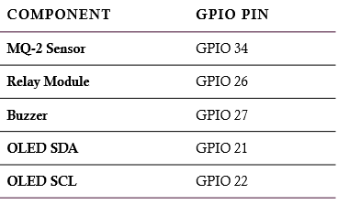
Pin Configuration

Slide 8


System Working
Gas Detection
  MQ-2 sensor continuously monitors gas levels to detect hazardous concentrations promptly.
  Alarm Activation
  ESP32 triggers buzzer and exhaust fan via relay when gas concentration exceeds threshold.
  Local Display Monitoring
  OLED screen shows real-time gas concentration for immediate local awareness and action.
  Remote Notification
  ESP32 sends gas data to IoT platform enabling remote alerts for enhanced safety.

Slide 9

Advantages of the System
Real-Time Monitoring
Automatic Safety Response
Remote IoT Alerts
Cost-Effective Design
Easy Scalability

Slide 10
Code

Slide 11
MQ-2 Gas Sensor Code
// Gas threshold
int gasThreshold = 3500;
#define MQ2_PIN 34 // MQ-2 connected to ESP32 analog pin
int gasValue = analogRead(MQ2_PIN);
Gas Alert Event (Blynk Notification)
Blynk.logEvent("gas_alert", "Gas Leakage Detected!");

Slide 12
Blynk Connection and Gas Value Sending
#define BLYNK_TEMPLATE_ID "TMPL6hLRYw2Ua"
#define BLYNK_TEMPLATE_NAME "Gas Leakage Detector"
#define BLYNK_AUTH_TOKEN "MdNO8UfAYqei6qXmg957RwnDt7DepVNT"
#include <WiFi.h>
#include <BlynkSimpleEsp32.h>
char ssid[] = "Infinix";
char pass[] = "ayesha246";
Blynk.begin(BLYNK_AUTH_TOKEN, ssid, pass);
Blynk.virtualWrite(V1, gasValue);

Slide 13
OLED Display Code
#include <Adafruit_GFX.h>
#include <Adafruit_SSD1306.h>
#define WIDTH 128
#define HEIGHT 64
#define OLED_ADDR 0x3C
Adafruit_SSD1306 display(WIDTH, HEIGHT, &Wire, -1);
display.clearDisplay();
display.setCursor(0,0);
display.println("Gas Leakage System");
display.print("Gas: ");
display.println(gasValue);
display.display();

Slide 14
Relay & Fan Control Code
#define RELAY_PIN 26 // Relay connected pin
pinMode(RELAY_PIN, OUTPUT);
if (gasValue > gasThreshold) {
digitalWrite(RELAY_PIN, LOW); // Fan ON
} else {
digitalWrite(RELAY_PIN, HIGH); // Fan OFF
}

Slide 15
Buzzer Alarm Code
#define BUZZER_PIN 27
pinMode(BUZZER_PIN, OUTPUT);
if (gasValue > gasThreshold) {
digitalWrite(BUZZER_PIN, HIGH); // Buzzer ON
} else {
digitalWrite(BUZZER_PIN, LOW); // Buzzer OFF
}

Slide 16

Conclusion and Future Enhancements
Current System Success
  The system reliably detects gas leaks using ESP32 and IoT,
  enabling quick local and remote alerts for improved safety.
  GSM Alert Integration
  Future enhancement includes SMS and call alerts using GSM
  modules for connectivity in areas without internet access.
  Data Logging and Analysis
  Implementing cloud-based data logging and graphical analysis
  will provide better monitoring and insights.

